Slide 1


EO-WIDGET
Building on Sen4CAP
Checks by Monitoring via commodity services/products
EO-WIDGET @ 7th Sen4CAP Webinar
2021.05.18

Slide 2








The Project EO-WIDGET for Evolution and Commercialization of
Satellite information services supporting the CAP
Checks by Monitoring System
Data as a Service
Widgets
Hosting
Marketplace
DK

Slide 3
USPs
Data as a Service
Widgets
On-demand Managed Services for:
EO satellite data discovery & ingestion
pre-processing
generation of signal-based monitoring products
wall-to-wall, whole season, coverage
Mini-applications for:
visualization of monitoring products (expert judgment)
quality assessments
building of Web Apps
re-use (open source software) and customization
DK

Slide 4
USPs
Hosting
Marketplace
Protected cloud workspace - individualized per Paying Agency:
deployment of Apps & tools
storing of
  declaration data
  configurations
  monitoring products
Business application:
catalogue of vendor offerings
self-service quote generation
subscription activation
billing management online
production progress monitoring
GT

Slide 5
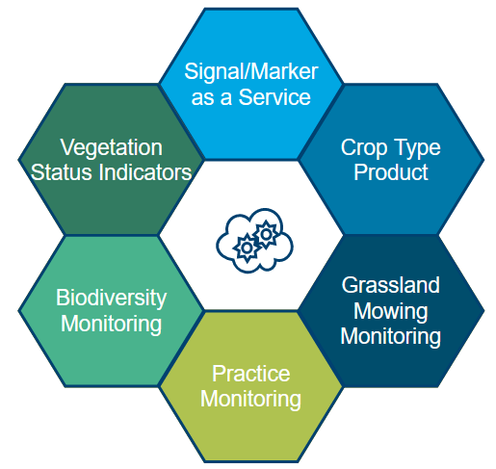
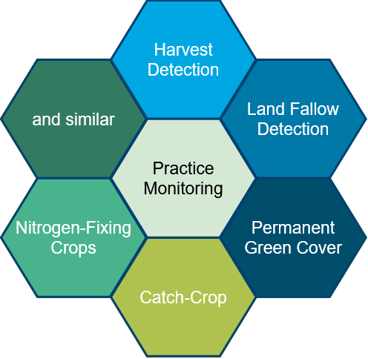
Product catalogue
Signal-based Monitoring Products
The initial set of data products (Data as a Service) is build on the foundation of Sen4CAP Algorithms and specifications.
Signal/Marker as a Service
Vegetation Status indicator
Cultivated Crop Type Map
Grassland Monitoring
Agricultural Practice Monitoring - summarizing individual services for:
  Harvest Detection
  Fallow Land Detection
  Catch Crop / Nitrogen Fixing Crop
  Permanent green cover
  and similar
Strong focus is on continued product development - > Sen4CAP Plus
DK

Slide 6
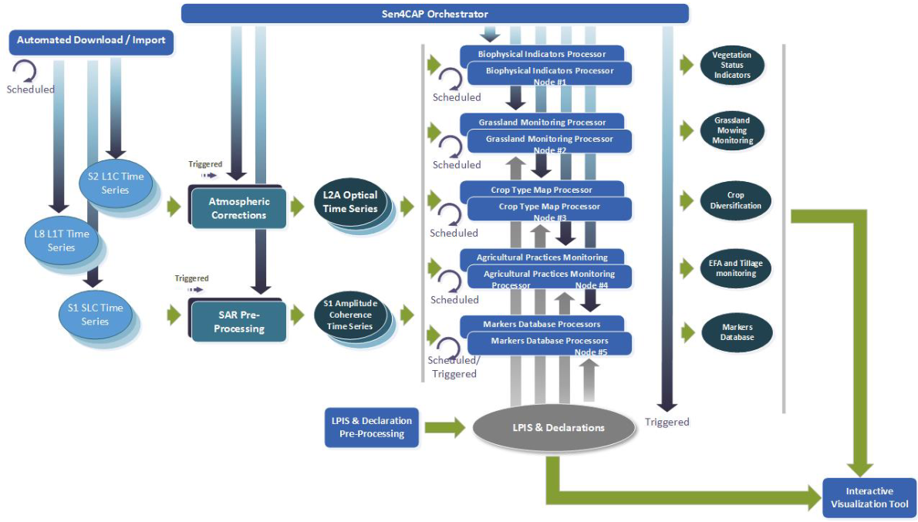
From a tool to a service

Slide 7
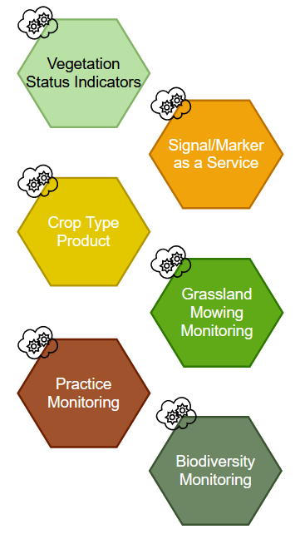
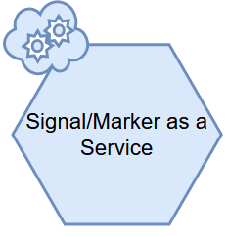


From a tool to a service
LPIS & Declaration Management

Slide 8


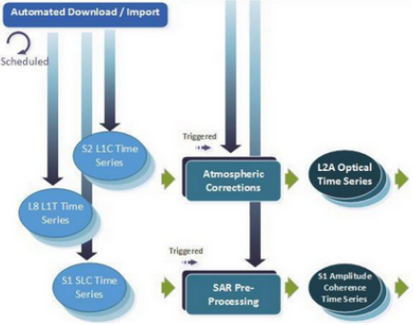
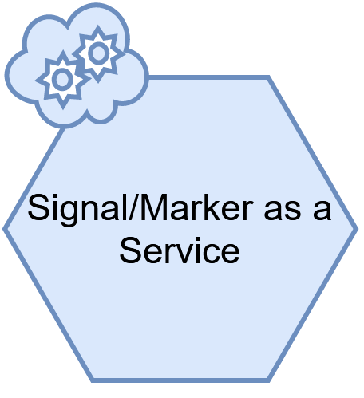


From a tool to a service
Managed IT-Service
Automated, monitored delivery of ready to use signal/makers
Not limited to Sentinel-1 and S2 (e.g. Planet, Kappazeta)
Marker specific band combinations, indexes - cloud free coverages for dedicate time periods
Processing on premise
Data as a Service
DK

Slide 9
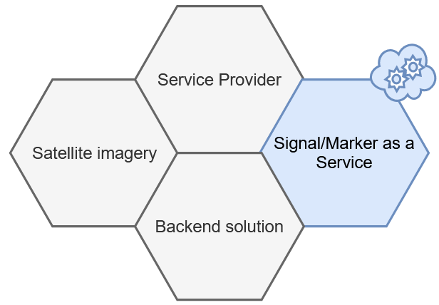
From a tool to a service
Managed IT-Service
Automated, monitored delivery of ready to use signal/makers
Not limited to Sentinel-1 and 2 (e.g. Planet, Kappazeta)
Marker specific band combinations, indexes - cloud free coverages for dedicate time periods
Processing on premise
Data as a Service
DK

Slide 10
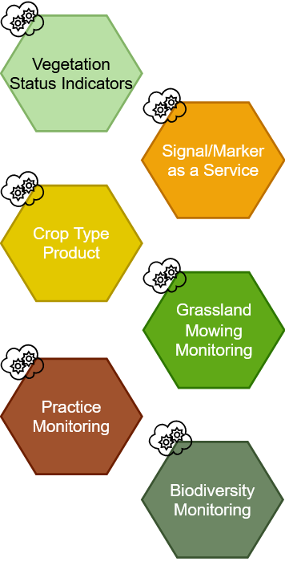
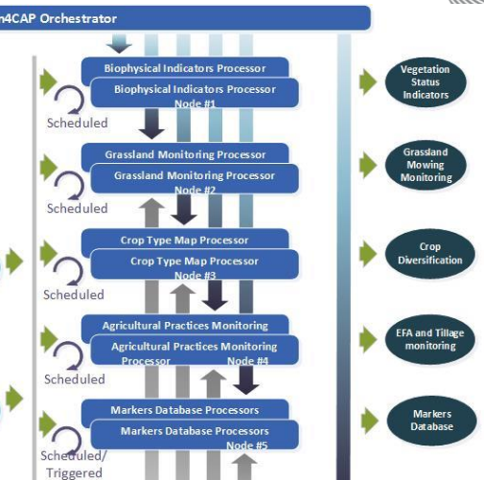
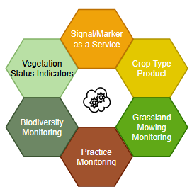
Checks by Monitoring (CbM) and Area Monitoring System - as a Service
Customer
Processing on premise
Data as a Service
CbM - aaS
DK

Slide 11
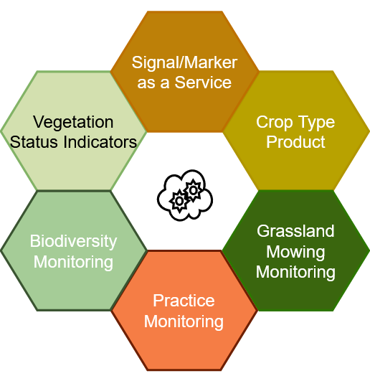
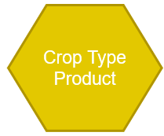
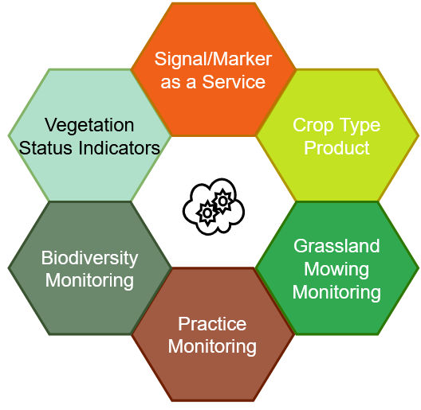
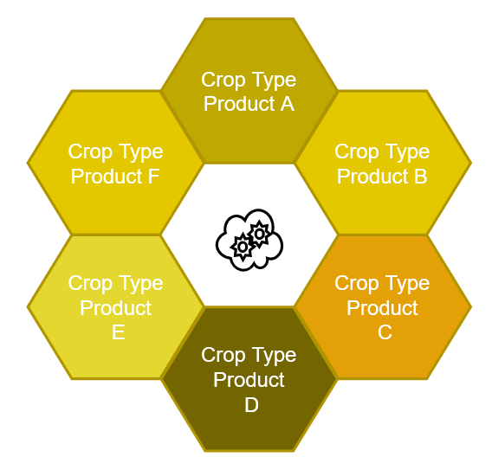
Checks by Monitoring (CbM) and Area Monitoring System
- as a Service
A
Products generated by contractor of choice
with local GSAA data and local configuration
(or by Paying Agency itself)
Support for specific national regulations
Various data suppliers supported
B
C
Configuration and Localisation
Flavored products for Paying Agency A, B, C, ...
DK

Slide 12
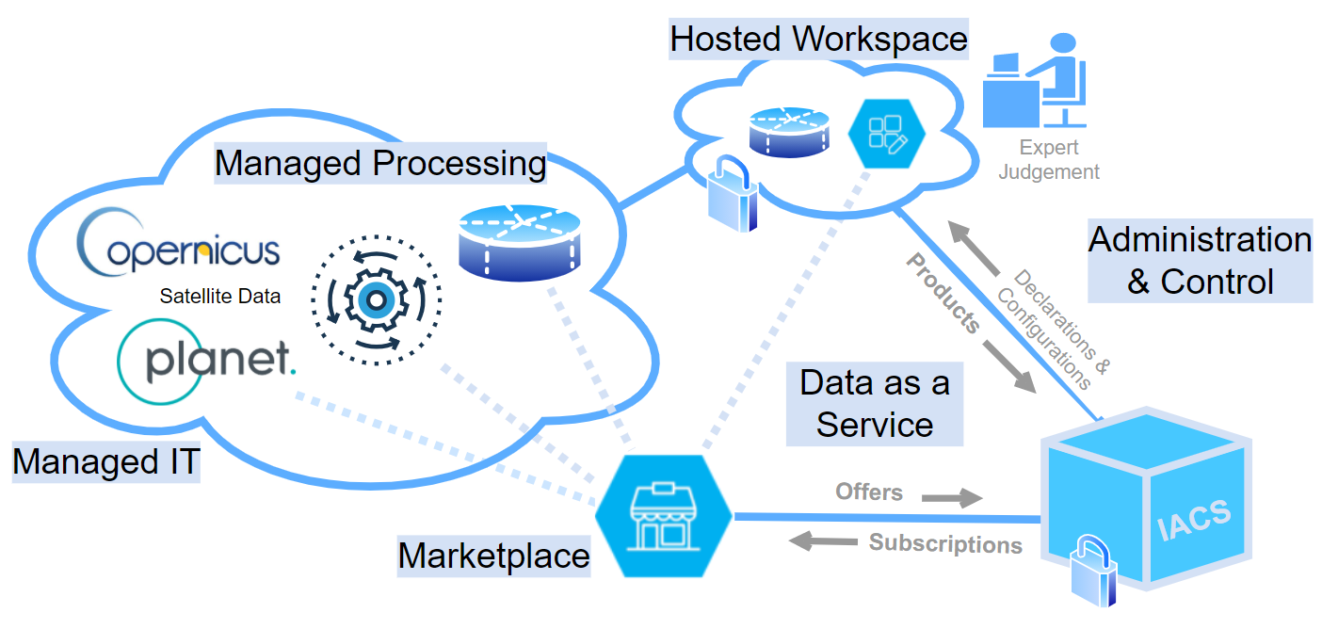

Service Architecture
EO-Widgets
Paying Agency
A, B, C, ...
GT
Notes:
The system concept builds exclusively on technology for provider-managed services operations on IT cloud infrastructures. The architecture components are coupled via Application Programming Interfaces (REST APIs).

Slide 13
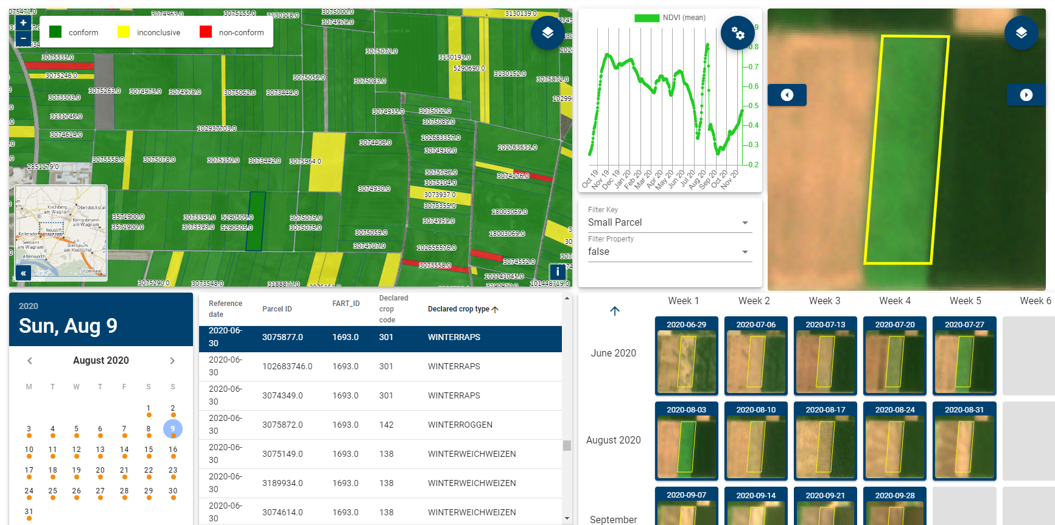
Widgets - Parcel Explorer App
Planet Fusion
inside (Beta)
GT

Slide 14
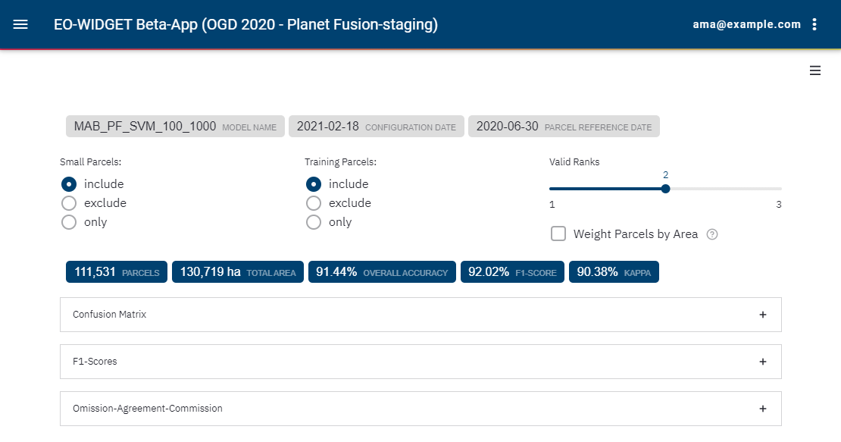
Quality Assessment Tool
GT

Slide 15
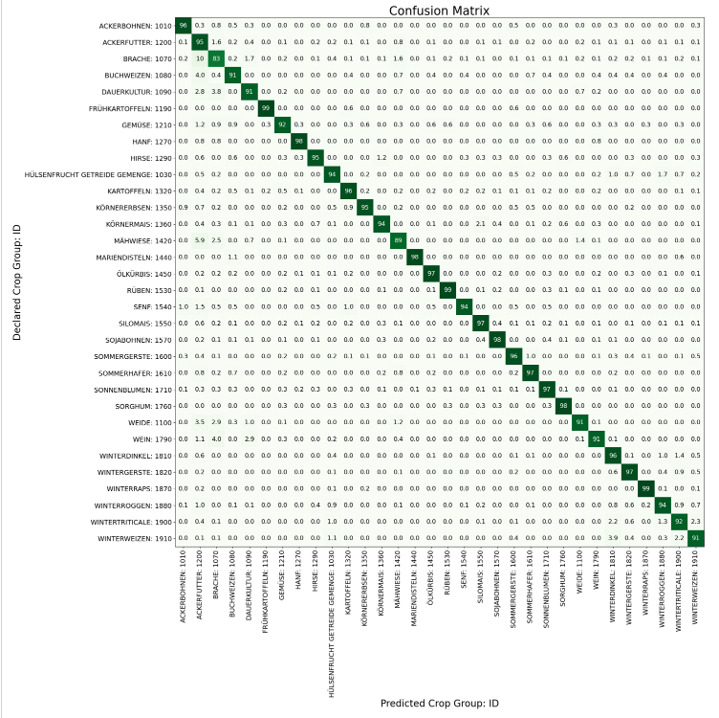
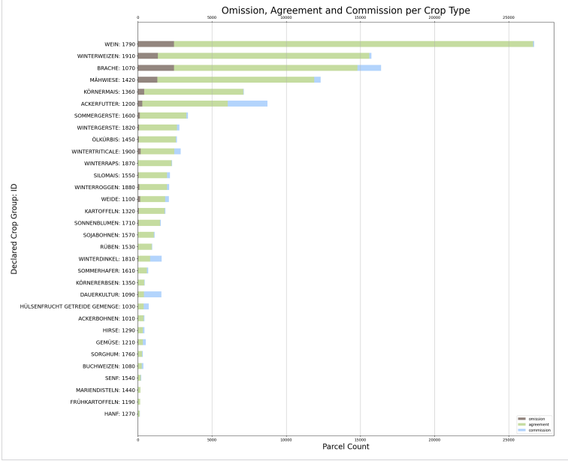
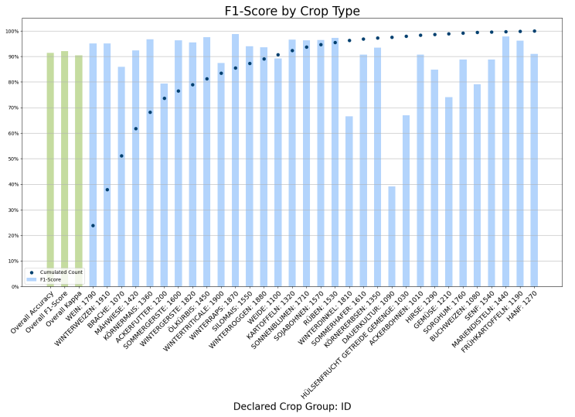
Quality Assessment Tool
True Positives, False Negatives
Confusion Matrix
F1-Score
GT

Slide 16
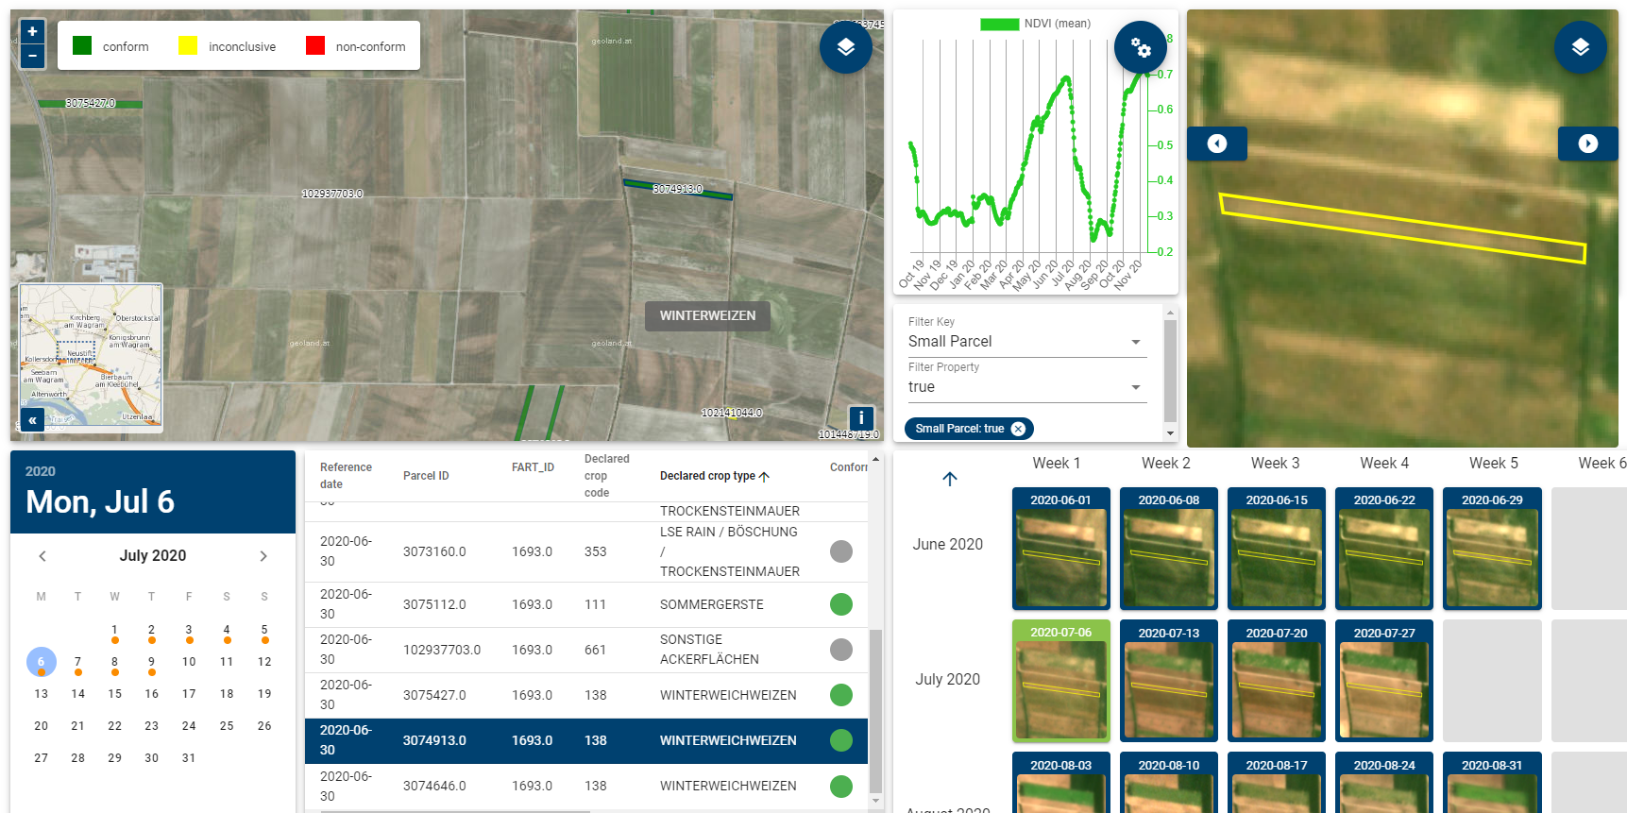
Inconclusive / Small Parcels
Planet Fusion
inside (Beta)
GT

Slide 17


LPIS and Declarations (GSAA)
GSAA / Declarations Handling
  by service provider of choice
  only essential information is exchanged (compliance check not necessarily at product level, but within PA)
Enrichment (e.g. small parcel identification)
Configuration
Parcel Explorer GUI
Quality Assessment Tools
Explicit data transfer process
Automated data pipeline
UI support
Configuration on
external VM
Cloud-based hosted
workspace
GT

Slide 18
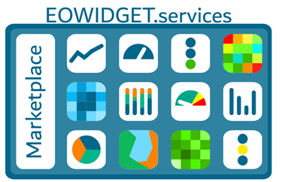
Benefits of approach - technical
Technical benefits
Offers a combined and flexible solution for the recent technological challenge of Paying Agencies
Alleviates the burden of costly satellite data ETL/management and signal processing
Thoroughly satisfies IACS information requirements by
  straightforward configuration of signal and markers according to individual strategic plans
  best-practice optimization and quality assessment
  digital products for monitorable agricultural land (parcel digital twins)
Managed IT-Service
  No on-premise installation needed
  Building on Sen4CAP - encapsulated algorithms
DK

Slide 19
Benefits of approach - organisational level
Organisational and legal aspects
Adaptive to the existing IACS infrastructure
Simplified procurement process with various providers possible
Outsourcing of Checks-by-Monitoring
Marketplace: “one-stop” shop for CbM
  various data providers and service providers within one hemisphere
  integration of legacy & heritage supply chains
all following GDPR and national legislations and PA’s data protection policies
Multi annual archiving
One-stop shop and subscription plans for vendor offerings to Paying Agencies, including self-service quote generation, ordering, billing and monitoring product activation
DK

Slide 20
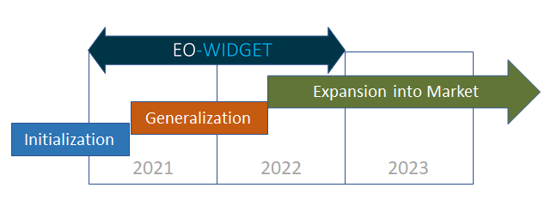
Activity Status
Accomplished so far:
Initialization phase close to finished:
Pre-processing for S-1 and S-2 data for Austria use case
Monitoring products
  for test sites successfully end-to-end integrated
  wall-to-wall production ready very soon
Proof of concept achieved:
  Outsourcing of monitoring
  Split in data products and widget visualisation
  Configuration and exchange of declaration data in a cloud environment
Next step: Generalization
Optimization and quality improvements
Planning
EO-WIDGET Project, before and beyond
DK

Slide 21






Open Value Chain - join as you like!
Interoperability via common workflows and complementary roles of stakeholders for optimum adjustment to Paying Agencies’ policies
EO Data Hubs
Application Ready Data
CbM Products
Workspaces
IACS
Farm Info
System
Value-
adder
Value-
adder
PaaS Provider
Paying Agency
Farmer
Commercial
SaaS Provider
Contractor
Advisor
DaaS
GT

Slide 22
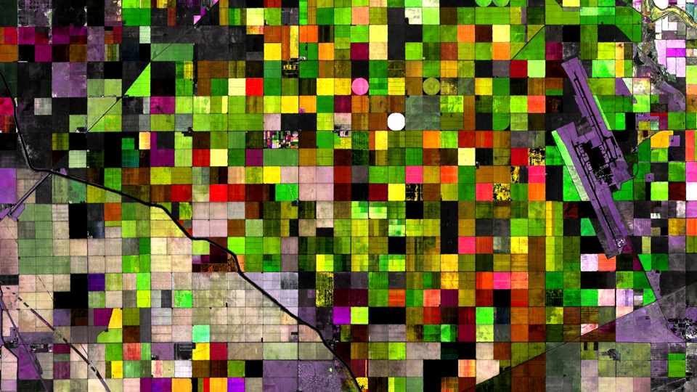
A proposition to Paying Agencies and/or their incumbent suppliers
New ways of implementing Checks by Monitoring via commodity services/products
Managed IT environment incorporating/evolving Sen4CAP specifications and algorithms
Implementation of local CAP strategies and SLA-based outsourcing becomes reality
Proof-of-concept achieved
full-country beta operations of 2021 growing season in Austria is ongoing
Checks by Monitoring - as a Service (CbM-aaS)
DK

Slide 23
Further Info
Project Web Site:
https://eowidget.services
Help and Stakeholder Liaisons:
David Kolitzus Gerhard Triebnig
kolitzus@geoville.at gerhard.triebnig@eox.at
+43 512 562021-29 +43 664 6207655
DK

